Slide 1
Data Analytics - Capstone Project
Dixie Peralta
Neeraja Jayaraman
Richelle Long
Nisha Bharakhada

Slide 2


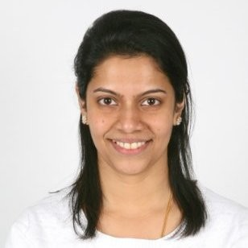
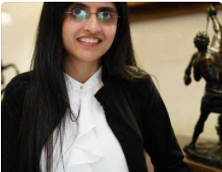

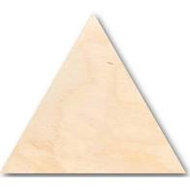


The Team
Dixie Perlata
Richelle Long
Neeraja Jayaraman
Nisha Bharakhada
Github / Database/Presentation
Github / Database/Presentation
Machine Learning Model/Presentation/Dashboard
Machine Learning Model/Presentation/Dashboard

Slide 3




Communication Protocol
Notes:
Microsoft Excel - To view the data once csv file is downloaded
Postgres SQL - To create a database
Python (Jupyter Notebook)
QBD - To create ERD diagram
Github
Google Drive - To keep all the documents at one central location

Slide 4
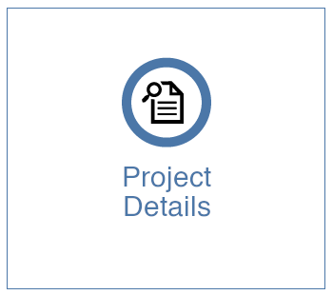
List of dataset reviewed
Selection of dataset
Reasons for selection
Description of the data source
ML Model for prediction

Slide 5
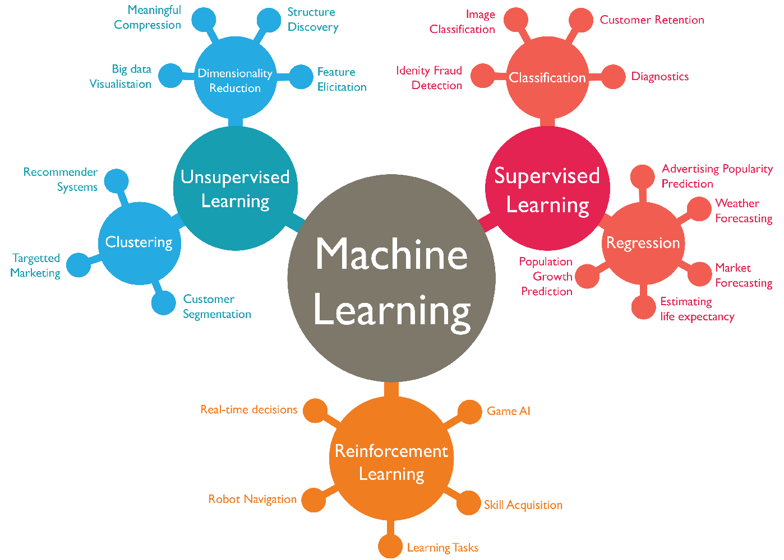
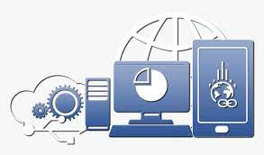


Data Analysis & Prediction using Machine Learning
Selection of Dataset
Tools and Technologies for Data Analysis
Machine Learning Model for Prediction

Slide 6

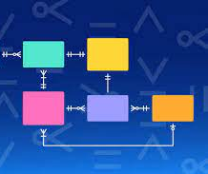




Tools/ Technologies Used

Slide 7
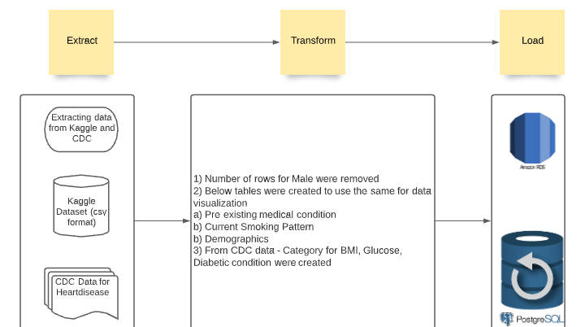

Slide 8
